Slide 1
Library Management System
Harikrishna Gonuguntla

Slide 2
Introduction
A library management system (LMS) is a Windows desktop application that a librarian uses to manage issues, accept returns, create users, add or remove books, collect overdue fees, and so on.
Customers of a library can use this application to search for a book and view the borrowing and return history.
This application automatically sends emails to customers after a successful borrow or return of a book.

Slide 3
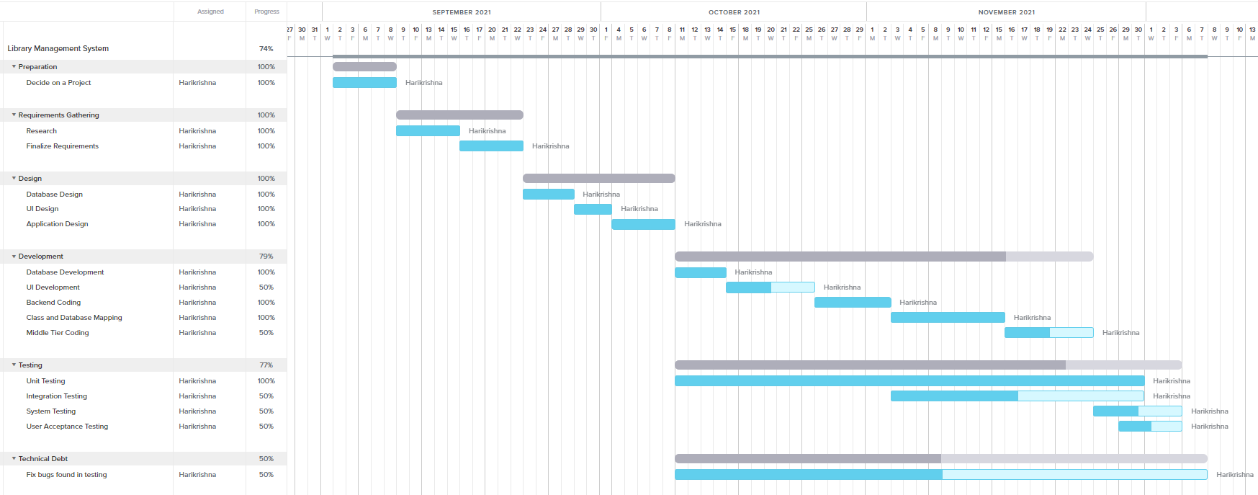
Project time goals

Slide 4
Changes since midterm
Completed borrow, return, and search functionalities for admin including user interface, middle code, database scripts and stored procedures individually.
Completed search functionality for customer.
Implemented email functionality.
View borrow/return history for customer is currently being implemented.
Need to combine all the individual components into a single application.

Slide 5
Change management plan
Creating goal.
Change team establishment.
Developing the plan.
Tracking the progress.
Testing.
Training.

Slide 6
Demo

Slide 7
Installation
A Library Management System.exe file will be delivered to the end-user.
User needs to install SQL server, SSMS and run scripts provided here.
Connection string needs to be changed in the code, to configure the application with the installed SQL server.
User needs to double click the.exe file in order to run the application.
Source code is available here, if somebody is interested to go through the project

Slide 8
Questions?

